Slide 1

Let’s Fix It:
Home Repairs and Maintenance

Slide 2

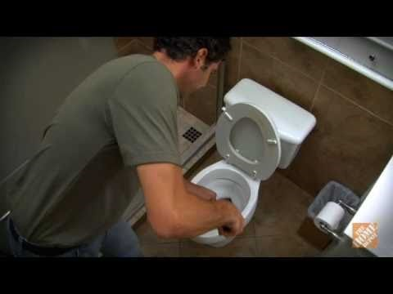
How to Unclog a Toilet

Slide 3
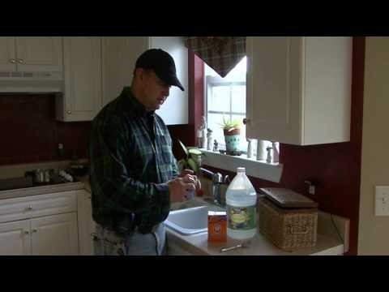
How to Unclog a Kitchen Sink

Slide 4
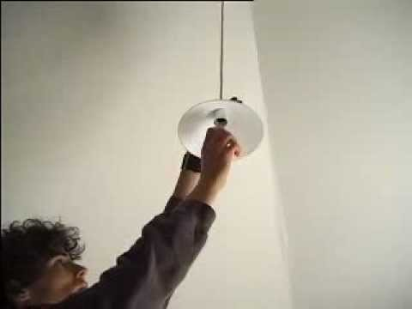
How to Change a Lightbulb

Slide 5

How to Patch a Hole

