Slide 1

Food Management:
Grocery Shopping & Food Preparation

Slide 2

Objectives
Participants will:
Assess their current knowledge of grocery shopping and food management.
Learn how to effectively grocery shop within a budget.
Discuss how to identify the appropriate way to store food.
Prepare a simple meal by following a recipe.

Slide 3

What Do I Know?
What Do I Need to Learn?

Slide 4

Nutrition Facts
Protein
Fats
Carbohydrates
Minerals
Vitamins

Slide 5
Grocery Budget
Set a grocery budget and stick to it
Average weekly food budget:
 | Low-Cost | Moderate-Cost | High-Cost
Female Ages 14-18 | $42.90 | $52.00 | $63.80
Female Ages 19-50 | $43.40 | $53.50 | $68.60
Male Ages 14-18 | $50.08 | $63.70 | $72.70
Male Ages 19-50 | $50.00 | $62.70 | $76.80

Slide 6
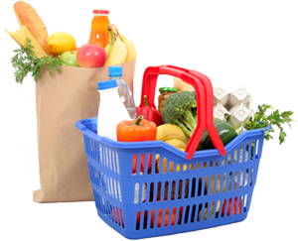

Grocery Shopping
Plan your menu for the week.
Check your pantry for the food items you will need for the week.
Check the newspaper/store flyers for sales.
Make a shopping list and buy only what is on your list.

Slide 7
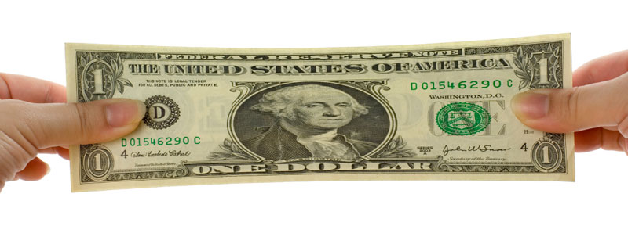
Stretching Your Grocery Budget

Slide 8

Tips for Saving Money
Check out the items marked “For Quick Sale” or “Close Out”.
Compare the unit prices of different brands and sizes to determine what is the best bang for your buck.
You don’t have to purchase name brand items.
Look for coupons.

Slide 9
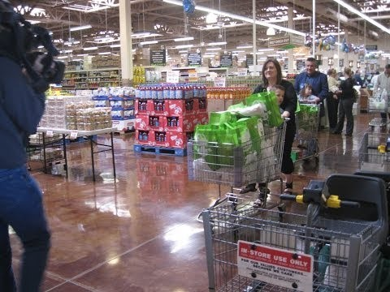
Couponing
www.youtube.com/watch?v=Og-wfmaJrP0

Slide 10
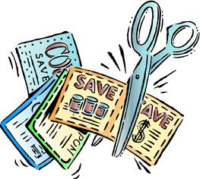
Couponing
Where can you find coupons?
Sunday newspapers
Printable coupon websites
  Coupons.com
  Smartsource.com
  Redplum.com
Mobile coupons or Apps
  RetailMeNot
  Cartwheel
Coupons inside products

Slide 11

Tips for Using Coupons
Try to match your coupons with weekly store sales to save the most money
Always check the price
of store brand products
Learn your grocery store’s
coupon policy
Check coupon expiration dates
Don’t purchase items you do not need

Slide 12
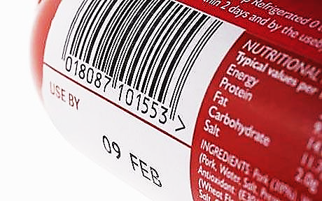
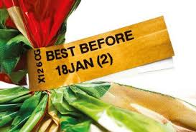
Be a Smart Shopper
When grocery shopping, check expiration dates for freshness.
“Sell by”
“Best if used by”
“Use by”

Slide 13
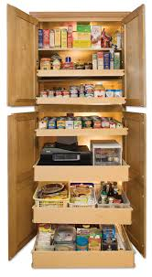
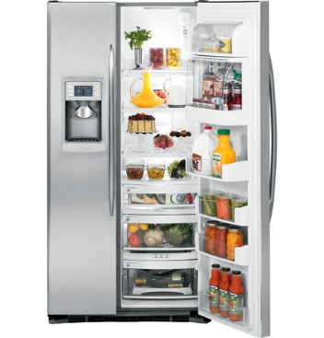
Storing Food Properly

Slide 14
Kitchen Safety
Keep electrical appliances away from water to avoid shocks. Stay away from electrical sockets, especially if your hands are wet.
If you burn yourself, hold the burned area under cool running water. Seek medical attention for severe burns.
Check that the oven and other cooking appliances are turned off before you leave the kitchen.

Slide 15
Kitchen Safety
Do not put knives or other sharp objects into a sink full of water.
Watch out for sharp knives. Cut in a motion that points away from your body.
Never put water on a cooking fire—it could make the fire bigger.
Do not put cooked food on a unwashed plate or cutting board that held raw food.

Slide 16
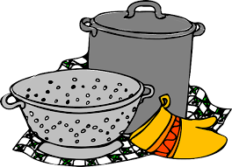
Kitchen Safety
Never add water to a pan that has hot oil in it.
Always turn pot handles in towards the back of the range top.
Keep paper towels, dish towels, and pot holders away fro the range top so they do not catch on fire.

Slide 17
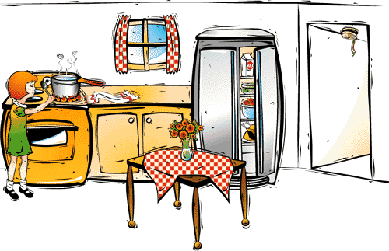
What Kitchen Hazards Do You See in This Picture?

Slide 18

Chopped Cooking Challenge

Slide 19

Questions?

