Slide 1

Good Sense:
Money Management

Slide 2


Learning Objectives
Participants will:
Understand the importance of managing your money
Identify how to distinguish between wants and needs
Learn how to create a monthly budget

Slide 3

How Do You Decide Your Money Goals?
Needs vs. Wants
Values
Goals

Slide 4
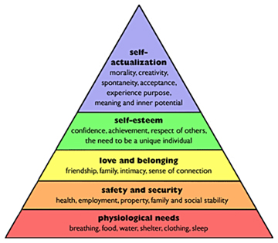
Needs vs. Wants
Maslow’s Hierarchy of Needs

Slide 5

What Do You Value?
Religion
Hard Work
Winning
Sharing
Family
Environment
Freedom
Friendship
Music
Love
Fun
Health
Beauty
Security
Safety
Arts

Slide 6


What are Your Goals?
What do you hope to accomplish:
  In the next three months?
  In the next year?
  In the next five years or longer?

Slide 7




What are Your Goals?
Will you be able to meet your basic needs?
Will you be able to meet your wants?
Will you be able to achieve your future dreams?

Slide 8
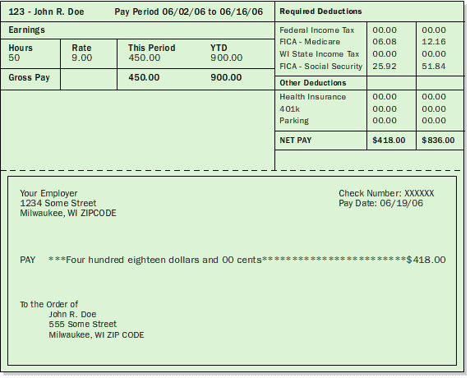
What is Your Budget?
This is your paycheck.

Slide 9



Where are You Going to Live?
Mortgage = $1500/month Room = $225/month
Apartment = $750/month
With roommate = $425/month

Slide 10



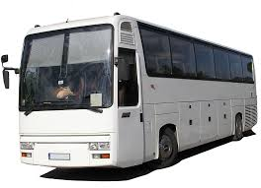
How Will You Get Where You Need to Be?
Paid: $500
Gas: $75/month
Insurance: $50/month
Free
Payment: $300/month
Gas: $200/month
Insurance: $100/month
Fare: $90/month

Slide 11
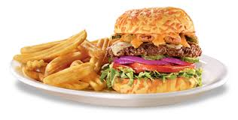


Where Will You Eat?
Groceries:
$60/week
Eating Out:
Breakfast: $5/day
Lunch: $7/day
Dinner: $12/day

Slide 12



Bills, Bills, Bills
Water
  House: $20/month
  Apartment: $15/month
  Room: Free
Heat/Air
  House: $75/month
  Apartment: $40/month
  Room: $25/month
Electricity:
  House: $75/month
  Apartment: $40/month
  Room: $25/month

Slide 13



And More Bills
Internet: $35/month
Cable/Satellite: $75/month
Cell Phone
  Unlimited: $100/month
  450 minutes: $55/month
  900 minutes: $75/month

Slide 14
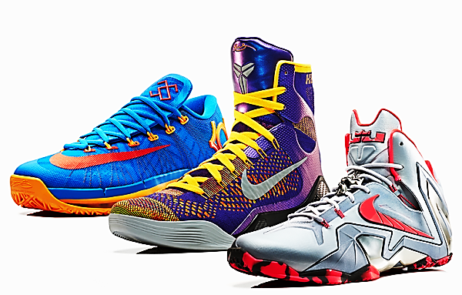


The Extras
Going to the Movies
Buying New Clothes, Shoes, Etc.
Concerts
Gym Memberships
Pets

Slide 15

What’s Left?
Based on your expenses vs. income, will you be able to save enough to accomplish your goals?
Where can you make cuts/sacrifices in order to be sure you have enough?
If an emergency arose (car breaks down, medical emergency, etc.) will you have enough money saved to cover it?

Slide 16

Questions?

