Slide 1

Can You Survive?
Understanding Banking and Credit

Slide 2

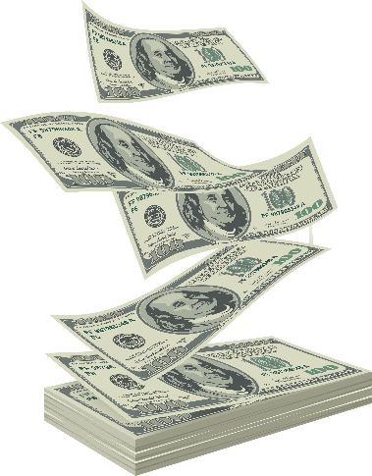
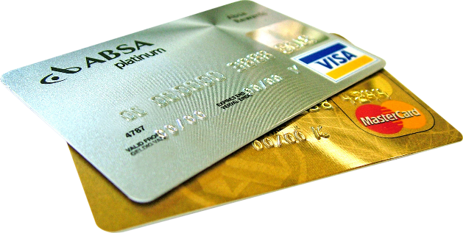
Learning Objectives
During this workshop, youth will:
  Define credit
  Understand the difference between good and bad credit
  Correctly fill out a check, deposit slip, and check register

Slide 3

Credit Basics
Credit is the ability to borrow money
  Buy now, pay later
Be aware of interest charges
  Depends on:
    Principal
    Term
    Interest Rate

Slide 4
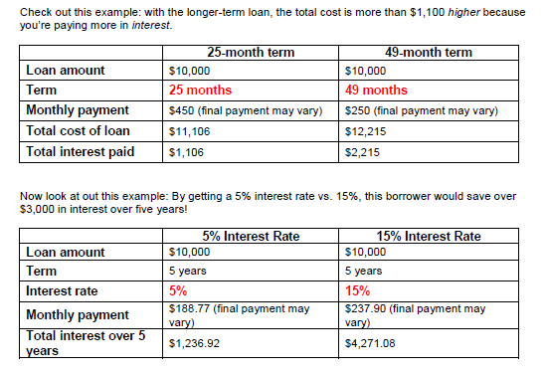
Interest Charges

Slide 5

Good Credit vs. Bad Credit
Good Credit
Bad Credit
Making payments on time
Home purchases
Equity (value) building purchases
Failure to pay on time or at all
Harder to borrow in the future
Loans that drain more than help

Slide 6


Why is credit important?
Can be useful in emergencies
More convenient than carrying cash
Allows for large purchases
May affect your ability to get:
  Employment
  Housing
  Insurance
  More Credit

Slide 7
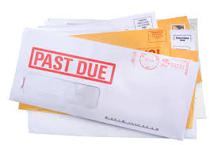
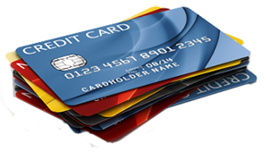
Tips for Building Good Credit
Pay off your entire credit card bill every month
Stop using it if you can’t pay it off
Pay on time to avoid late fees
Ignore credit card offers
Be aware that money borrowed costs money
Avoid title loans and payday loans

Slide 8
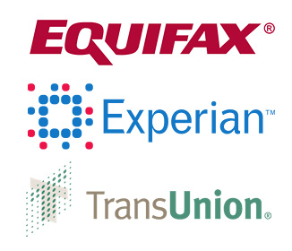
Your Credit Report and Score
Your credit score determines how likely you are to get a loan
Your credit report is free
once every twelve months
Don’t pay for a credit
report unless you have to

Slide 9

What’s on Your Credit Report?
Basic demographic information
Payment and credit history
Credit inquiries
Public record information

Slide 10
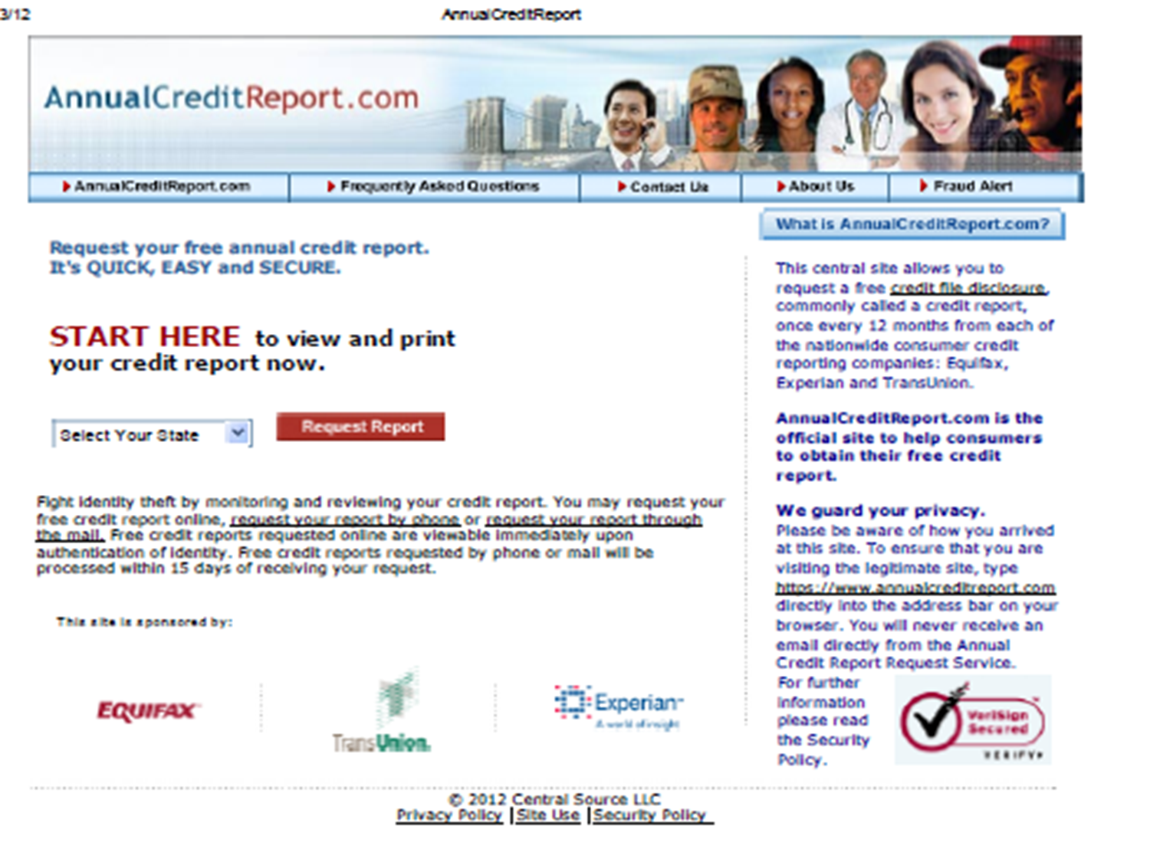
Accessing Your Report

Slide 11

Take It to the Bank
Opening an account
  Which bank?
  What type of account?
  Provide personal information
    Two forms of identification
    Cash for deposit
  Select the products you want with your account

Slide 12
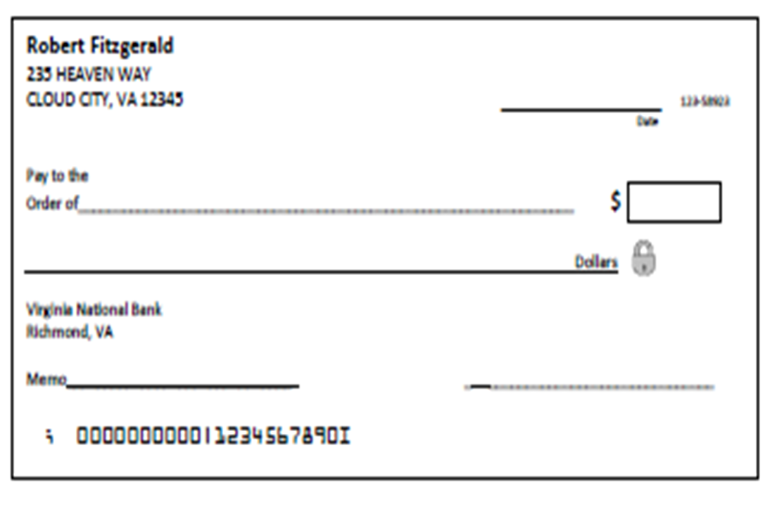
Filling Out a Check
H
A
B
C
D
F
E
G

Slide 13
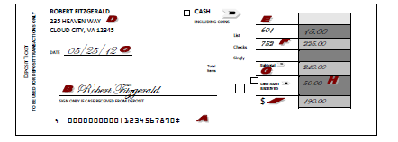
Filling out a Deposit Slip

Slide 14
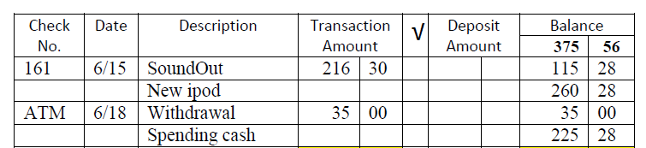
Tracking Your Money

Slide 15
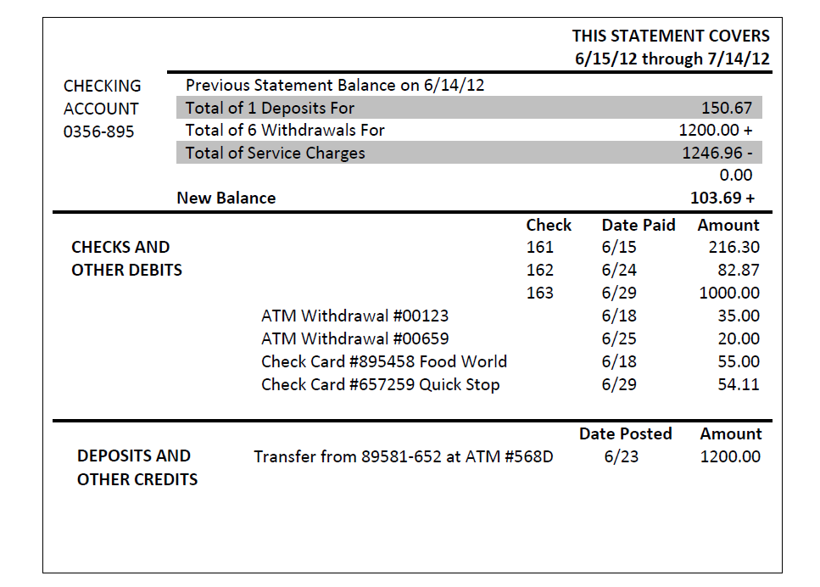
Bank Statement

Slide 16

Financial Survivor
Can your team outwit, outplay, and outlast your opponents to be the ultimate survivor?

Slide 17
Rules for the Game
Get in groups of 3-4 and pick a tribe name.
Each time you get a question right, you get a challenge and a chance at bonus points.
Use your immunity idol to pass on a question or challenge and receive a free point. You must surrender the idol once it is used.
The secret final challenge will be revealed at the end of the game for additional points.

Slide 18

Good Luck Survivors!

Slide 19
Question 1
When you receive goods and services now, and pay for them later, you are using what?

Slide 20
Answer 1
Credit

Slide 21
Challenge 1
Name at least two of the three credit bureaus.

Slide 22
Challenge 1 Answer
Equifax, Experian, Transunion

Slide 23
Question 2
Name at least two items that are taken out of your paycheck before you get it.

Slide 24
Answer 2
Federal Income Tax
State Income Tax
Social Security
Medicare contributions

Slide 25
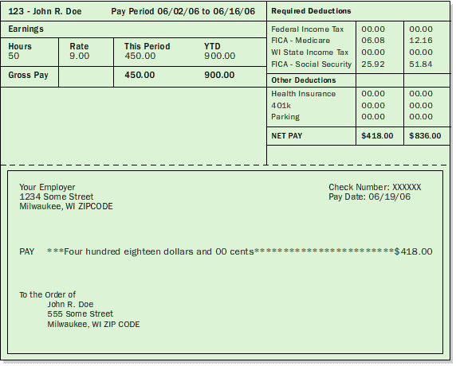
Challenge 2
How much Federal Income tax was deducted during this pay period?

Slide 26
Challenge 2 Answer
$0.00

Slide 27
Question 3
Name two things you must have to open a bank account.

Slide 28
Answer 3
Identification and money to deposit.

Slide 29
Challenge 3
On April 24, 2014 you purchased a new outfit from Macy’s with a check.
Fill out the check for your purchase.
Pants- $22.99
Shirt- $17.99
Shoes- $35.99
Subtotal- $76.97
Tax- $3.46

Slide 30
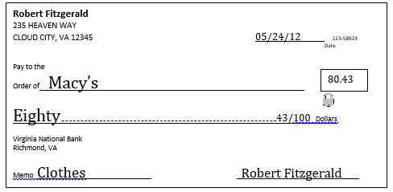
Challenge 3 Answer

Slide 31
Question 4
If you do this when you write a check, you will always know your account balance.

Slide 32
Answer 4
Use your check register.

Slide 33
Challenge 4
List two ways you can build good credit.

Slide 34
Challenge 4 Answer
Pay off your entire credit card bill every month.
Pay bills on time to avoid late fees.
Ignore credit card offers.
Avoid title loans and payday loans.
Make equity (value) building purchases.

Slide 35
Question 5
Your bank statement will show:
  Current amount in account
  Amount in account at the time statement was printed
  Up to date list of withdrawals and deposits
  All of the above

Slide 36
Answer 5
B. Amount in account at the time the statement was printed.

Slide 37
Challenge 5
Name two things that are listed on your credit report.

Slide 38
Challenge 5 Answer
Demographic information (name, birthdate, address, social security number)
Payment and credit history
Inquiries from creditors
Public records information (bankruptcies, foreclosures, etc.)

Slide 39
Question 6
How can good or bad credit affect your life? List two ways it can impact you.

Slide 40
Answer 6
Employment – Help or hinder you from getting a job
Housing – Good credit helps you get an apartment or home
Insurance – Companies may not provide services to people with bad credit
More credit – Bad credit makes it difficult to get loans

Slide 41
Challenge 6
You received five birthday cards with the following enclosures:
  $75 in cash
  $50 check #123
  $35 check #526
  $25 in cash
  $25 check #725
Deposit half into your checking account, and get half back in cash. Fill out the deposit slip.

Slide 42
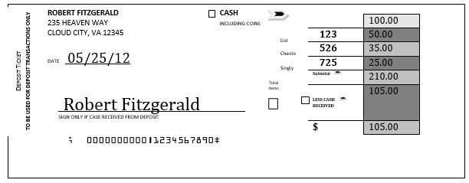
Challenge 6 Answer

Slide 43
Question 7
What is stored in the magnetic strip on the back of your credit/debit card?

Slide 44
Answer 7
Your account number

Slide 45
Challenge 7
Name one thing you should not use when choosing a PIN number.

Slide 46
Challenge 7 Answer
Birthdates
Street address
Social security number

Slide 47
Question 8
What is the free website you can use to access your credit report?

Slide 48
Answer 8
www.annualcreditreport.com

Slide 49
Challenge 8
What is the name of the form you use to put money (checks/cash) into the bank?

Slide 50
Challenge 8 Answer
Deposit Slip

Slide 51
Question 9
When deciding to purchase an item, the best thing to ask yourself is…?

Slide 52
Answer 9
Do I need this?

Slide 53
Challenge 9
True or False? If I pay my credit card in full by the due date I will not owe any interest.

Slide 54
Challenge 9 Answer
True. If you pay the entire balance within the grace period allowed (usually about 28 days), you will not owe any interest on your purchases.

Slide 55
Question 10
How often can you request to see your credit report for free?

Slide 56
Answer 10
Once a year.

Slide 57
Challenge 10
True or False? If I pay the minimum monthly payment on a credit card bill, then I won’t owe any interest.

Slide 58
Challenge 10 Answer
False. After you subtract the minimum payment from your balance, finance charges will be added to your remaining balance. So avoid the minimum payment trap. Pay your bill in full, or as close to in full as you can.

Slide 59
Question 11
What is it called when you spend more money that what is in your account?

Slide 60
Answer 11
An overdraft.

Slide 61
Challenge 11
Justin just found a job with a take-home pay of $2200 per month. His expenses are:
  Rent: $800
  Groceries: $200
  Transportation: $200
  Clothing: $100
  Restaurants: $150
  Miscellaneous: $250
How long will it take him to save $1000?

Slide 62
Challenge 11 Answer
2 months

Slide 63
Question 12
True or False? Your credit score determines how likely you are to get a loan.

Slide 64
Answer 12
True. Your credit score helps lenders decide if you’re a good credit risk or not. The higher the score, the lower the risk. The higher your credit score, the more likely they are to give you a loan and the better the interest rate lenders are likely to offer you – which means more money in your pocket!

Slide 65
Challenge 12
True or False? When opening a credit card, it’s good to find the card with the highest interest rate.

Slide 66
Challenge 12 Answer
False. The higher the interest rate, the more you pay in the long run.

Slide 67
Final Challenge
Determine how many points your team will risk.
Complete the final challenge on the next slide.

Slide 68
Final Challenge
Fill out the given checks, deposit slips, and register to balance your checkbook.

Slide 69
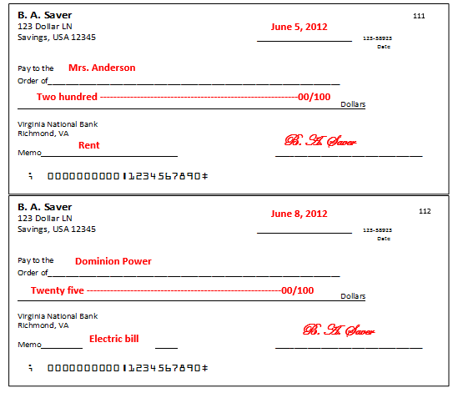
Final Challenge Answer (Part 1)

Slide 70
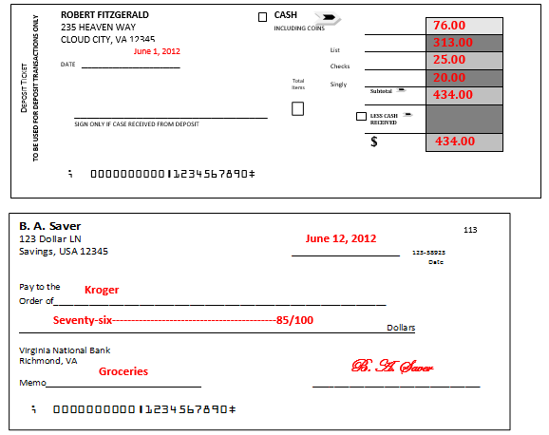
Final Challenge Answer (Part 2)

Slide 71
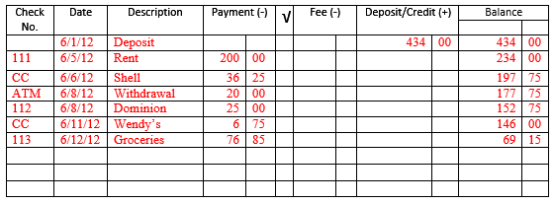
Final Challenge Answer (Part 3)

Slide 72

Congratulations
You have survived!

Slide 73
Survivor
Created by Lora O’Neill and Bridget S. 2/6/2006
email: themathelk@hotmail.com
Adapted from Template TCEA 2002
www.be-a-gameshow-host.wikispaces.com

